Slide 1
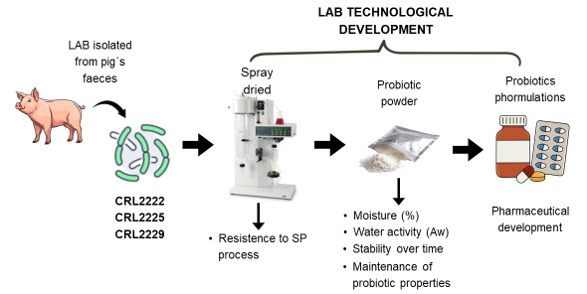

Production of probiotic lactobacilli biomass for in-feed supplementation to growing pigs and sows
Preserving microbial viability is a key aspect in the development of probiotic formulations. The present study evaluated the effect of spray drying on the porcine probiotic strains Limosilactobacillus reuteri CRL2222, Lactobacillus amylovorus CRL2225, and Lactobacillus johnsonii CRL2229, using a pre-formulated protective mixture.
The results demonstrated that spray drying is a suitable method for obtaining probiotic bacteria powder for administration to piglets and sows. The probiotic strains withstood the drying process and remained stable for 60 days (< 6 log CFU/g), retaining their beneficial properties.
Uezen JD, Miranda MH, Obregozo M, Aristimuño C, Vignolo GM , Nader Macías MEF
DOI:https://doi.org/10.19137/cienvet.v28.9434

